Slide 1

Introduction to Python (Week 1)
Louis Rey
UCSD Extension

Slide 2
Course Objective
Understand the rules and syntax used in programming languages
Familiarity with programming constructs
Writing functional code in Python
Preparation for advancement into more in-depth programming courses
Write command-line programs with documentation
Make Python modules that can be imported to other Python programs
Add documentation to modules for automatic documentation usage
Understand basic OOP principles and how to create new classes or classes derived from other classes
Create unit tests and follow test-driven development principles
Use the Python standard library modules
Install Python packages into a project to use them

Slide 3
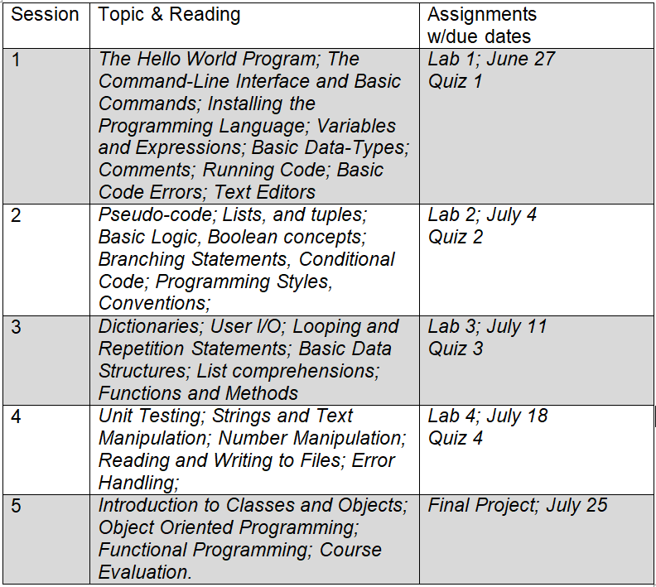
Course Schedule and Content

Slide 4
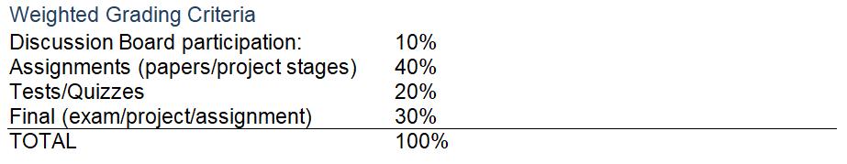
Grading and Coursework

Slide 5
Week 1 Objectives
The Hello World Program
The Command-Line Interface and Basic Commands
Installing the Programming Language
Variables and Expressions
Basic Data-Types
Comments
Running Code
Basic Code Errors
Text Editors

Slide 6
What is Python
Python is an interpreted, object-oriented, high-level programming language with dynamic semantics.
Its high-level built in data structures, combined with dynamic typing and dynamic binding, make it very attractive for Rapid Application Development, as well as for use as a scripting or glue language to connect existing components together.

Slide 7
What Industries Use Python Today?
Python is used in area such as
- Data Science
- Artificial Intelligence
- Machine Learning
- Computer Vision
- The internet of things (IOT)
- Robotics
- Web design
- Electrical Engineering
- Communications
- Engineering Simulation
- Industrial Automation
- Quantum Computing
- And many more

Slide 8
Python
• Open source general-purpose language
• Object Oriented, Procedural, Functional
• Easy to interface with C/ObjC/Java/Fortran
• Easy-ish to interface with C++ (via SWIG)
• Great interactive environment
• Downloads: http://www.python.org
• Documentation: http://www.python.org/doc/
• Free book: https://diveintopython3.problemsolving.io/

Slide 9
2.5.x / 2.7.x / 3.x ???
• “Current” version is 3.8.x
• “Mainstream” versions 2.7.x , 3.5.x
• The new kid on the block is 3.9.0
It is recommended to start from 3.5.x although 2.7.x may still be supported in some areas

Slide 10
Installing & Running Python

Slide 11
Binaries
• Python comes pre-installed with Mac OS X and Linux
• Windows binaries from http://python.org/
• You might not have to do anything!

Slide 12
The Python Interpreter
• Interactive interface to Python on Linux or Mac
>>> python3
Python 2.5 (r25:51908, May 25 2007, 16:14:04)
[GCC 4.1.2 20061115 (prerelease) (SUSE Linux)] on linux2
Type "help", "copyright", "credits" or "license" for more information.
>>>
• Python interpreter evaluates inputs:
>>> 3*(7+2)
27
• Python prompts with ‘>>>’
• To exit Python:
• CTRL + D or type quit( ) in the command line

Slide 13
Running Programs on UNIX Based Systems
>> python3 filename.py
You could make the *.py file executable and add the following #!/usr/bin/env python to the top to make it runnable.

Slide 14
Pick Your Flavor
• Large collection of proven modules included in the standard distribution
https://docs.python.org/3/

Slide 15
numpy
• Offers Matlab-ish (scientific modeling and simulation) capabilities within Python
• Fast array operations
• 2D arrays, multi-D arrays, linear algebra etc.
• Downloads: https: //numpy.org/
• Tutorial: https://numpy.org/doc/stable/

Slide 16
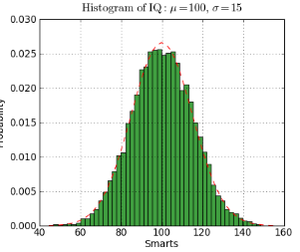
matplotlib
• High quality plotting library.
#!/usr/bin/env python
import numpy as np
import matplotlib.mlab as mlab
import matplotlib.pyplot as plt
mu, sigma = 100, 15
x = mu + sigma*np.random.randn(10000)
# the histogram of the data
n, bins, patches = plt.hist(x, 50, normed=1, facecolor='green',
alpha=0.75)
# add a 'best fit' line
y = mlab.normpdf( bins, mu, sigma)
l = plt.plot(bins, y, 'r--', linewidth=1)
plt.xlabel('Smarts')
plt.ylabel('Probability')
plt.title(r'$\mathrm{Histogram\ of\ IQ:}\ \mu=100,\ \sigma=15$')
plt.axis([40, 160, 0, 0.03])
plt.grid(True)
plt.show()
• Downloads: https://matplotlib.org/

Slide 17
What version will we be using?
• Python 3.8 or higher
• Download Link: https://www.python.org/downloads/
• Python IDLE shell
Other alternatives that include multiple packages
• IPython
• Python-xy

Slide 18
Custom Distributions
• Anaconda Navigator:
https://anaconda.org/anaconda/anaconda-navigator
• Anaconda Navigator is a desktop
graphical user interface included in
Anaconda that allows you to launch
applications and easily manage conda
packages, environments and channels
without the need to use command line
commands
• PyCharm: https://www.jetbrains.com/pycharm/
• PyCharm is designed by programmers,
for programmers, to provide all the tools
you needed for productive Python
development

Slide 19
The Basics

Slide 20
Interactive Help
To enter help topics you will need to type help( ) on the command line
>>> help( )
Once in the interactive help menu you can find more information on any object or function
To exit the help menu simply press CTRL + C or quit on the command line

Slide 21
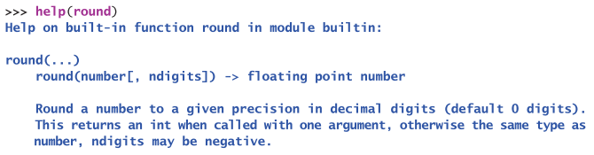
Interactive Help Example

Slide 22
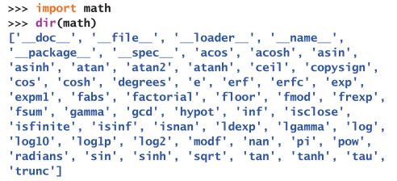
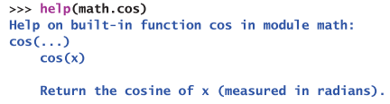
Python Modules

Slide 23
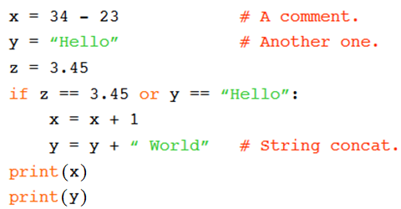
A Code Sample
Note: In Python 2.7.x, the print statement did not require a parenthesis around the element needed to print out
print x

Slide 24
Enough to Understand the Code
• Assignment uses = and comparison uses ==
• For numbers + - * / % are as expected
• Special use of + for string concatenation
• Special use of % for string formatting (as with printf in C)
• Logical operators are words (and, or, not) not symbols
• The basic printing command is print
• The first assignment to a variable creates it
• Variable types don’t need to be declared
• Python figures out the variable types on its own

Slide 25
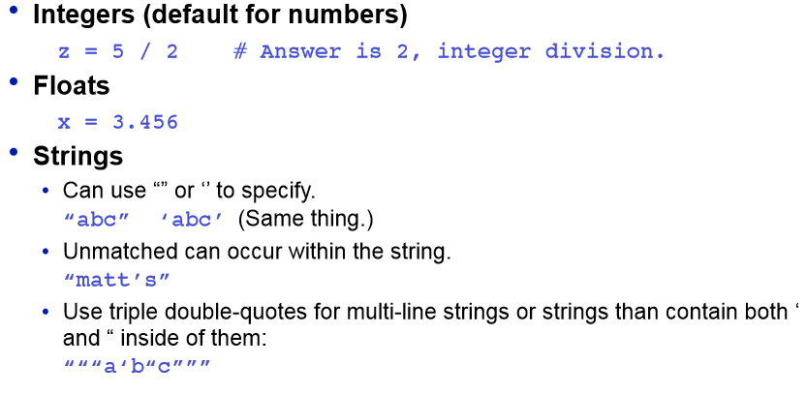
Basic Datatypes

Slide 26
Whitespace
Whitespace is meaningful in Python: especially
indentation and placement of newlines
• Use a newline to end a line of code
• Use \ when must go to next line prematurely
• No braces { } to mark blocks of code in Python…
Use consistent indentation instead
• The first line with less indentation is outside of the block
• The first line with more indentation starts a nested block
• Often a colon appears at the start of a new block (e.g. for function
and class definitions)

Slide 27
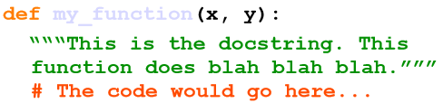
Comments
• Start comments with # – the rest of line is ignored.
• Can include a “documentation string” as the first line of any
new function or class that you define.
• The development environment, debugger, and other tools use it:
it’s good style to include one.

Slide 28
Assignment
• Binding a variable in Python means setting a name to hold a
reference to some object.
• Assignment creates references, not copies
• Names in Python do not have an intrinsic type. Objects have types. • Python determines the type of the reference automatically
based on the data object assigned to it.
• You create a name the first time it appears on the left side of an assignment expression:
>>> x = 3
>>> x=y=3
• A reference is deleted via garbage collection after any names bound
to it have passed out of scope

Slide 29
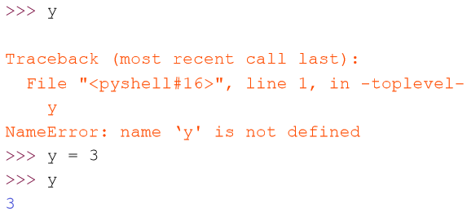
Accessing Non-Existent Names
• If you try to access a name before it’s been properly created (by
placing it on the left side of an assignment), you’ll get an error.

Slide 30
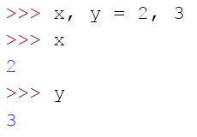
Multiple Assignment
• You can also assign to multiple names at the same time.

Slide 31
Naming Rules
• Names are case sensitive and cannot start with a number.
They can contain letters, numbers, and underscores.
bob Bob _bob _2_bob_ bob_2 BoB
• There are some reserved words:
and, assert, break, class, continue, def, del, elif, else, except, exec, finally, for, from, global, if, import, in, is, lambda, not, or, pass, print, raise, return, try, while

Slide 32
Understanding Reference Semantics in Python

Slide 33
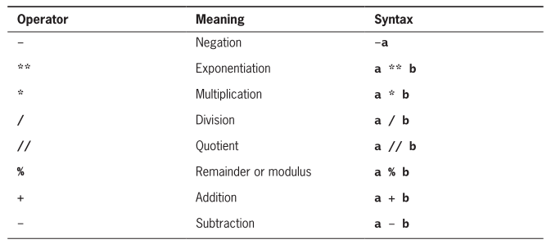
Arithmetic Expressions

Slide 34
Precedence Rules
Exponentials have the highest precedence and is evaluated first
Unary negation is evaluated next, before multiplication, division, and remainder
Multiplication, both types of division, and remainder are evaluated before addition and subtraction
Addition and subtraction are evaluated before assignment
You can use parentheses to change the order of evaluation

Slide 35
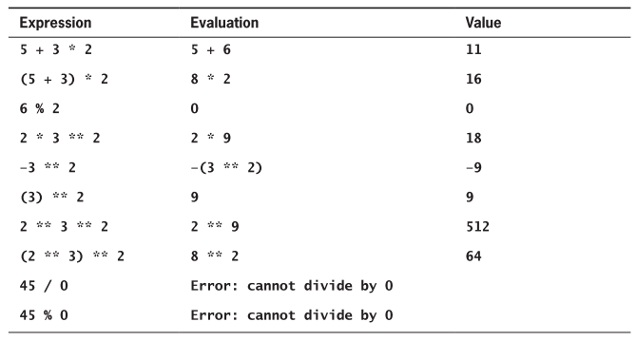
Precedence Rules Examples

Slide 36
Understanding Reference Semantics
• Assignment manipulates references
- x = y does not make a copy of the object y references
- x = y makes x reference the object y references
• Very useful; but beware!
• Example:
>>> a = [1, 2, 3] # a now references the list [1, 2, 3] >>> b = a # b now references what a references
>>> a.append(4) # this changes the list a references >>> print b # if we print what b references,
[1, 2, 3, 4] # SURPRISE! It has changed…
Why??

Slide 37
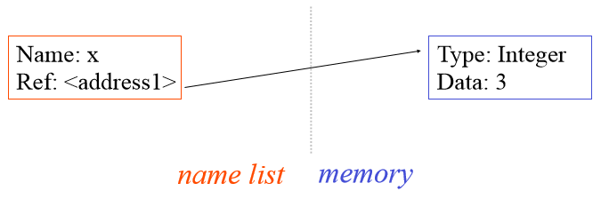
Understanding Reference Semantics
• There is a lot going on when we type:
x = 3
• First, an integer 3 is created and stored in memory
• A name x is created
• A reference to the memory location storing the 3 is then
assigned to the name x
• So: When we say that the value of x is 3
• We mean that x now refers to the integer 3

Slide 38
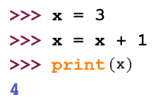
Understanding Reference Semantics
• The data 3 we created is of type integer. In Python, the datatypes
integer, float, and string (and tuple) are “immutable.”
• This doesn’t mean we can’t change the value of x, i.e. change
what x refers to …
• For example, we could increment x:

Slide 39
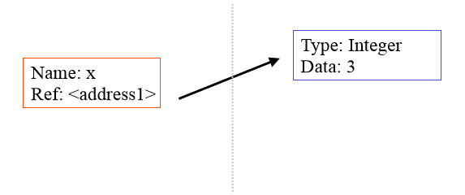
Understanding Reference Semantics
• If we increment x, then what’s really happening is:
1. The reference of name x is looked up.
2. The value at that reference is retrieved.

Slide 40
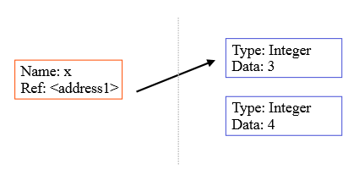
Understanding Reference Semantics
• If we increment x, then what’s really happening is:
1. The reference of name x is looked up.
2. The value at that reference is retrieved.
3. The 3+1 calculation occurs, producing a new data element 4
which is assigned to a fresh memory location with a new reference.

Slide 41
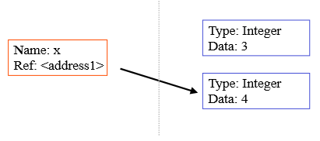
Understanding Reference Semantics
• If we increment x, then what’s really happening is:
1. The reference of name x is looked up.
2. The value at that reference is retrieved.
3. The 3+1 calculation occurs, producing a new data element 4 which is assigned to a fresh memory location with a new
reference.
4. The name x is changed to point to this new reference

Slide 42
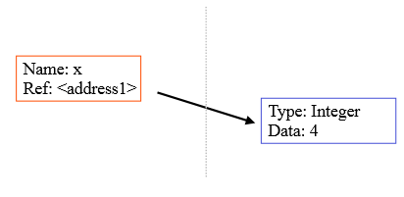
Understanding Reference Semantics
• If we increment x, then what’s really happening is:
1. The reference of name x is looked up.
2. The value at that reference is retrieved.
3. The 3+1 calculation occurs, producing a new data element 4
which is assigned to a fresh memory location with a new
reference.
4. The name x is changed to point to this new reference.
5. The old data 3 is garbage collected if no name still refers to it.

Slide 43
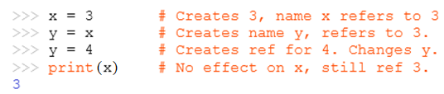
Assignment 1
• So, for simple built-in datatypes (integers, floats, strings), assignment
behaves as you would expect:

Slide 44
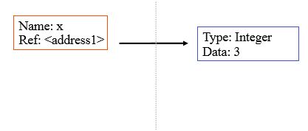
Assignment 1
• So, for simple built-in datatypes (integers, floats, strings), assignment
behaves as you would expect:

Slide 45
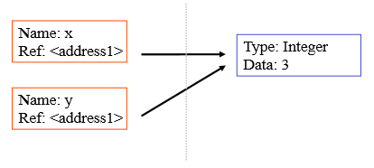
Assignment 1
• So, for simple built-in datatypes (integers, floats, strings), assignment
behaves as you would expect:

Slide 46
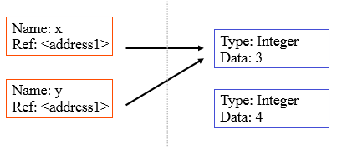
Assignment 1
• So, for simple built-in datatypes (integers, floats, strings), assignment
behaves as you would expect:

Slide 47
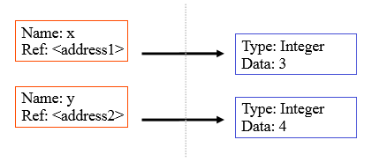
Assignment 1
• So, for simple built-in datatypes (integers, floats, strings), assignment
behaves as you would expect:

Slide 48
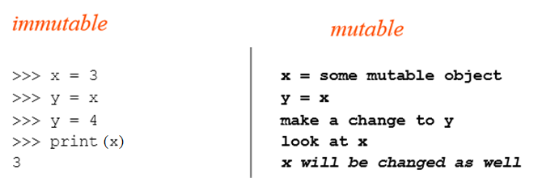
Assignment 2
• For other data types (lists, dictionaries, user-defined types),
assignment works differently.
• These datatypes are “mutable.”
• When we change these data, we do it in place.
• We don’t copy them into a new memory address each time.
• If we type y=x and then modify y, both x and y are changed.

Slide 49
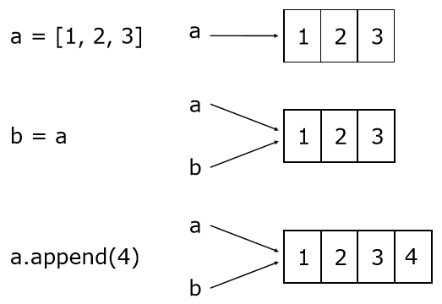
Changing a Shared List

Slide 50
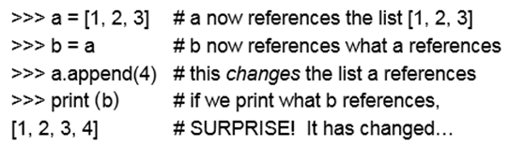
Our surprising example surprising no more...
• So now, here’s our code:

Slide 51
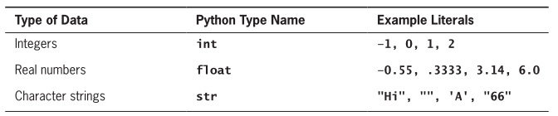
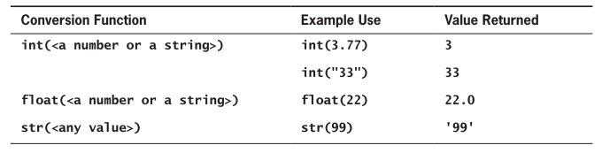
Data Types and Data Type Conversion

Slide 52
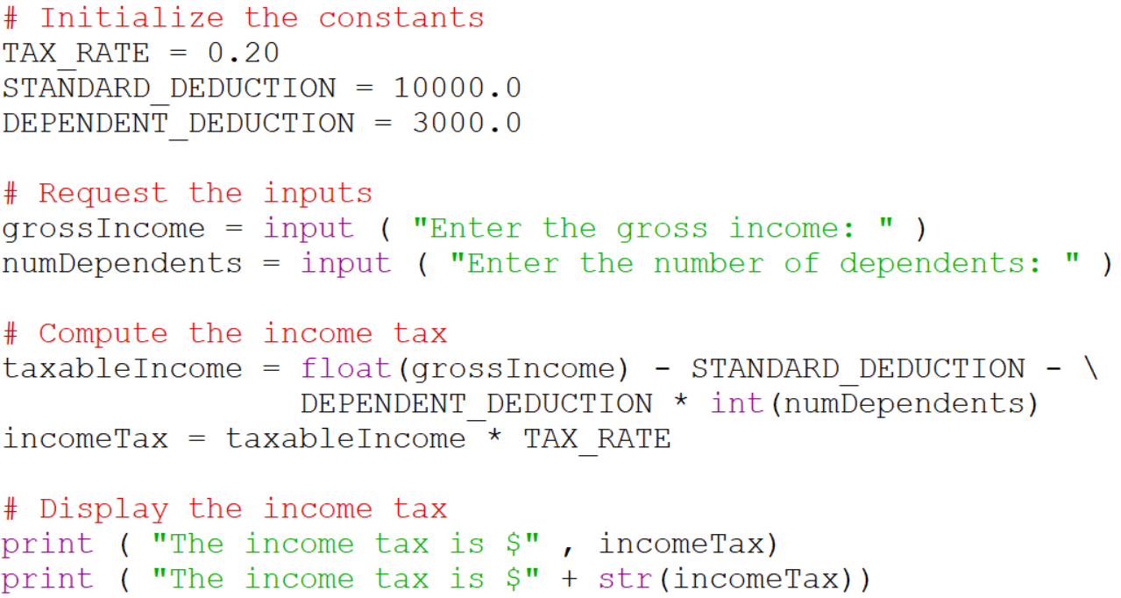
Data Input and Data Conversion Example

Slide 53
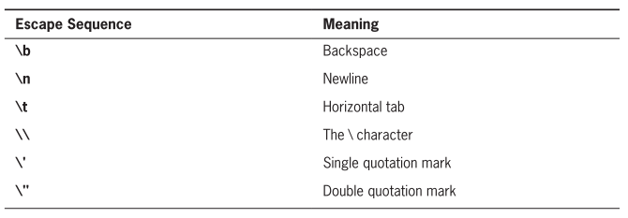
Escape Sequences

Slide 54
Resources
Matt Huenerfauth (Penn State)
Guido van Rossum (Google)
Richard P. Muller (Caltech)
Bill Boyd (Weslayan University)
Smithsonian Telescope Data Center
Programming Python, Mark Lutz
Fundamentals of Python, Kenneth Lambert

